Slide 1
CPIMS+ Training
Administrator

Slide 2
Introduction
Name
Position
Organisation
Expectations
Notes:
Introduce yourself and the other trainers.
Ask each participant to introduce themselves with it:
name,
position,
organization and
expectations for this training.
Record the expectations on a flipchart and return to them after the presentations in the next slide (objective and learning outcomes) explaining what will and will not be included in the training.

Slide 3
Objectives and learning outcomes
Know how to navigate in CPIMS+
Master the CPIMS+ configuration
Master the creation of new users

Slide 4
About this training
For those who will be in charge of configuring CPIMS+ and dealing with the following
User accounts
Teams (user groups)
Forms

Slide 5
About this training
Note: You may lack access to some of these features, depending on your role in your organization

Slide 6
Responsibilities of the administrators
CPIMS+ System Administrator
Responsible for all configuration changes based on requests and coordination Ensure data backups Ensure the link with helpdesk for updates and troubleshooting Ensure data quality control Focal point for Agency Administrators (decentralized administrators) Focal point for troubleshooting via Agency administrator Link to IT services for device management Organize continuous capacity building for end users (case workers and managers)
Notes:
In addition to configuration and users, you must also back up your data. This applies to both cases and must be recorded separately.
Go in the cases, click on the actions, then export JSON. Name the file as Country Name and Date and save it. Do the same in the Incidents section to record incident data.
This should be done once a month.

Slide 7
Responsibilities of the administrators
CPIMS+ Agency Administrator
Administer users within the different teams
Ensure data backups Ensure data quality control Organize continuous capacity building for end users (case workers and managers)
Notes:
In addition to configuration and users, you must also back up your data. This applies to both cases and must be recorded separately.
Go in the cases, click on the actions, then export JSON. Name the file as Country Name and Date and save it. Do the same in the Incidents section to record incident data.
This should be done once a month.

Slide 8
Definitions
Overview of functions, groups and users
Users are individuals using CPIMS + Functions are what defines the actions of a user in the system (what he may or may not do) User groups are used to create user teams and allow different levels of data access in the group.

Slide 9
Forms

Slide 10
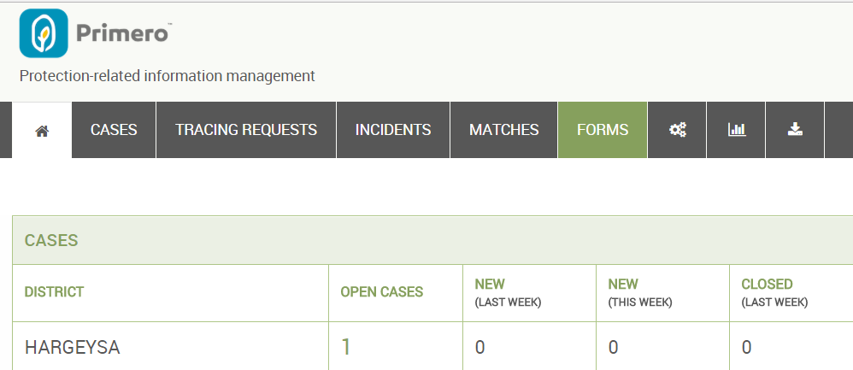
Editing an existing form
Click on the “Forms” button in the navigation tab

Slide 11
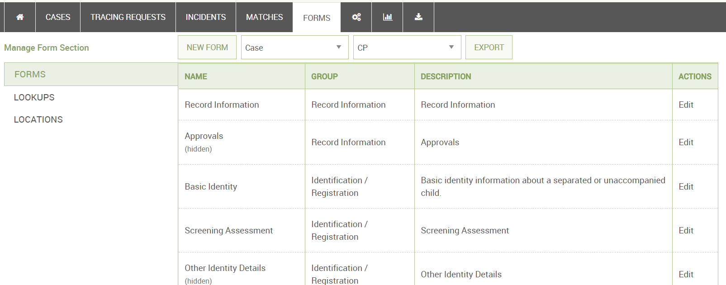
Editing an existing form
Click “Edit” button next to any form

Slide 12
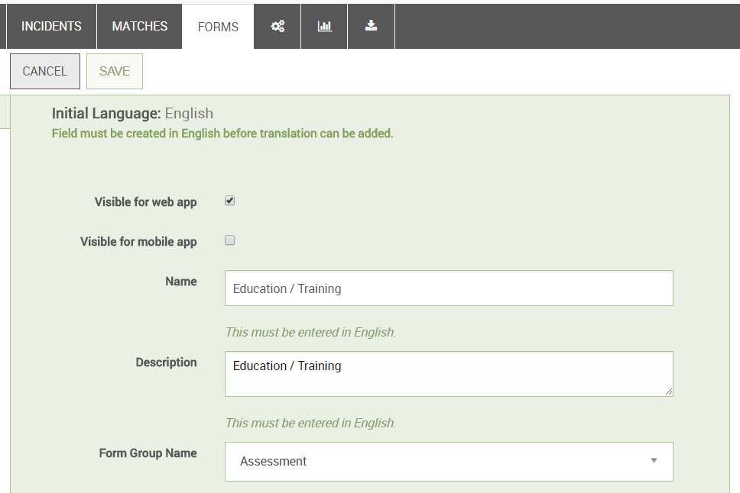
Editing an existing form
You will now see basic information about the form.

Slide 13
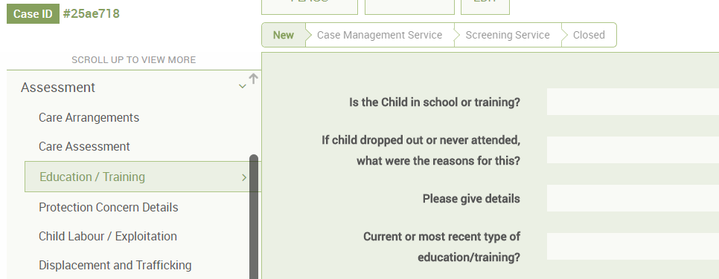
Editing an existing form
Changing the form group changes how users will see the form organized

Slide 14
Editing an existing form
You can also hide or show the form, and decide whether it appears on the Primero mobile application

Slide 15
Form Fields

Slide 16
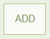
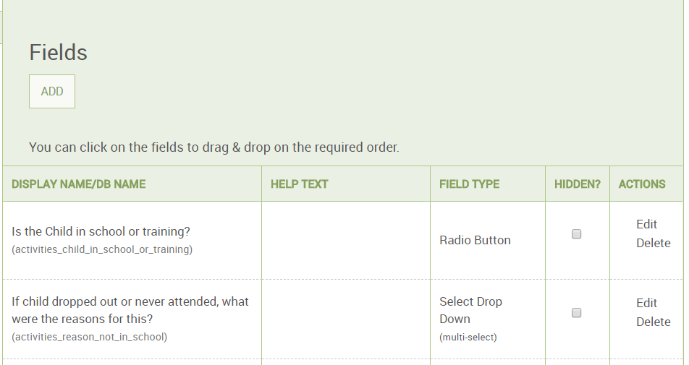
Form fields
If you scroll down the Edit Form page, you will see a list of fields.
Click the “Edit” button next to one of them.
Click the “Add” button to add a new one.

Slide 17
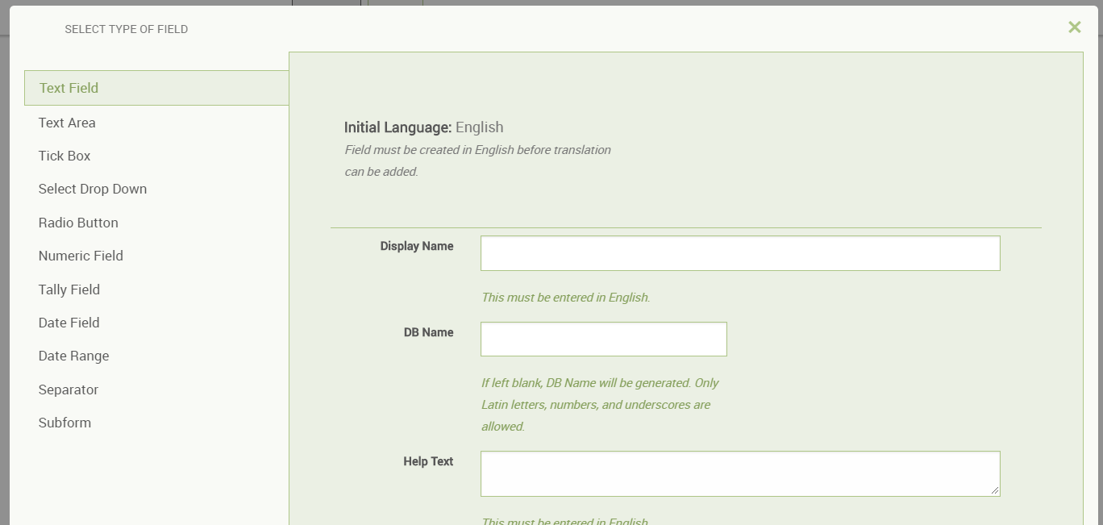
Adding a new form field
You can now select a field type and specify your field’s attributes.

Slide 18
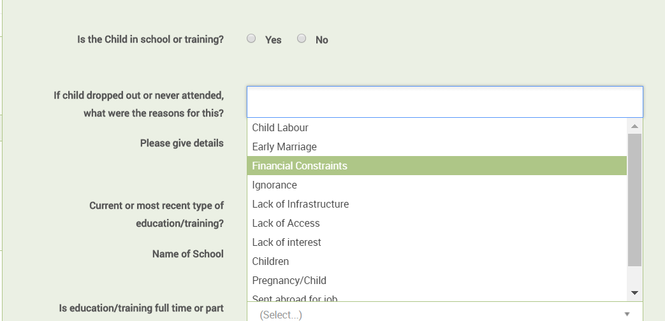
Field Types and Attributes
Radio Buttons
Display Name

Slide 19
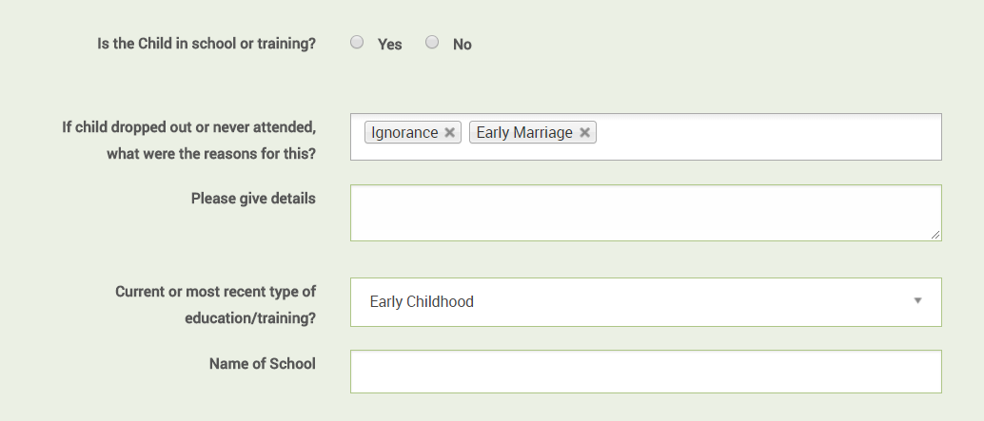
Field Types and Attributes
Select Dropdown (Single)
Select Dropdown (Multi)
Textarea (bigger than text field)
Text field

Slide 20
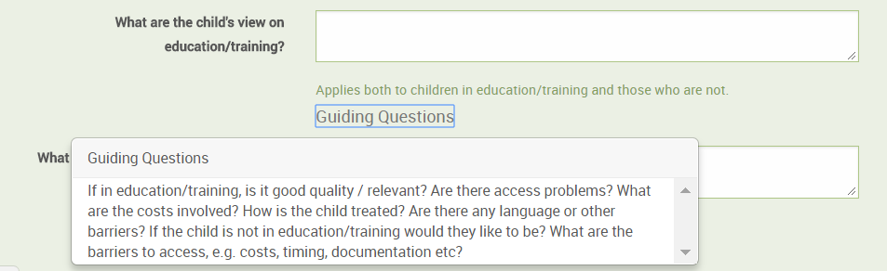
Field Types and Attributes
Help Text
Guiding Questions (These appear by clicking on the “Guiding Questions” link.)

Slide 21
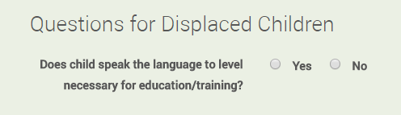
Field Types and Attributes
Separator
Field Options

Slide 22
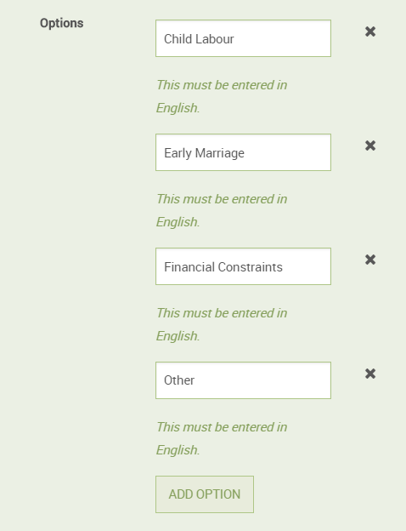
Editing field options
You can change which options appear for a select dropdown or radio button
Click to a remove existing option
Click to a new option

Slide 23
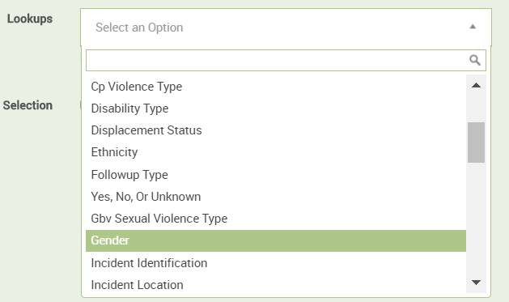
Editing field options
You can also set a field to take its options from a “Lookup” - a list of options used by numerous fields.

Slide 24
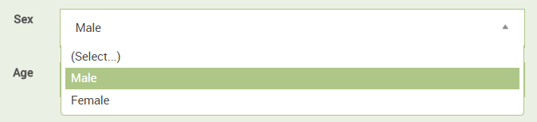
Editing field options
Selecting the “Gender” lookup for your field, like in the example above, will mean that your field displays the gender lookup values as options

Slide 25
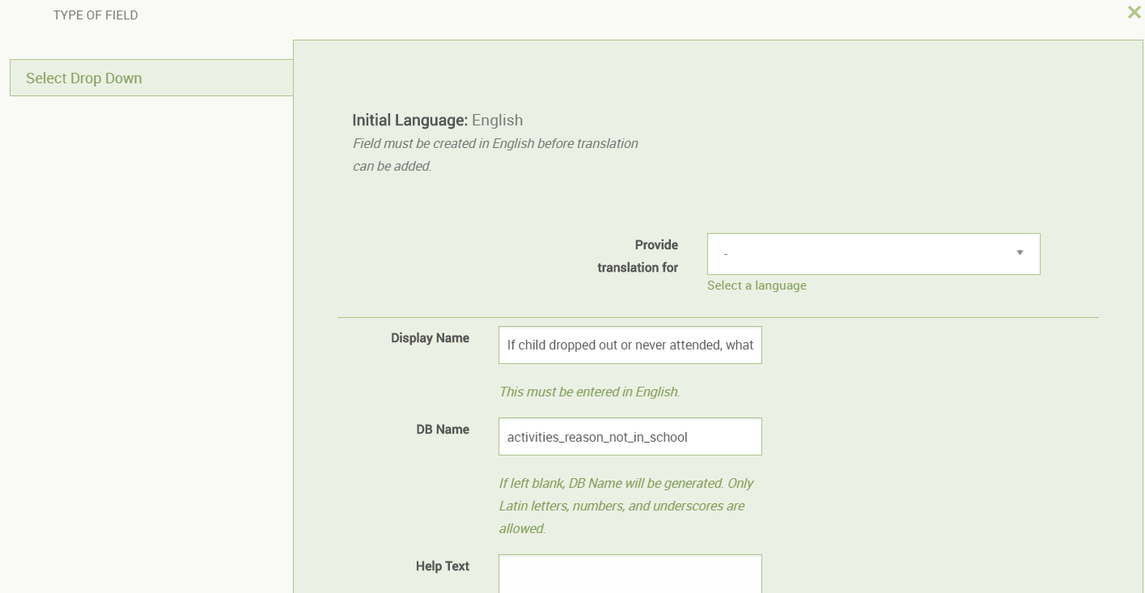
Editing a form field
Editing a form field is just like adding a form field, except that you cannot change the field type

Slide 26
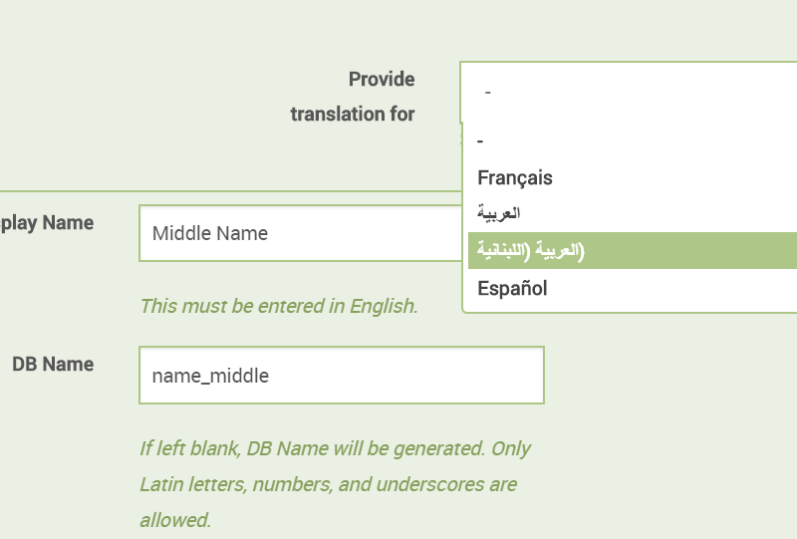
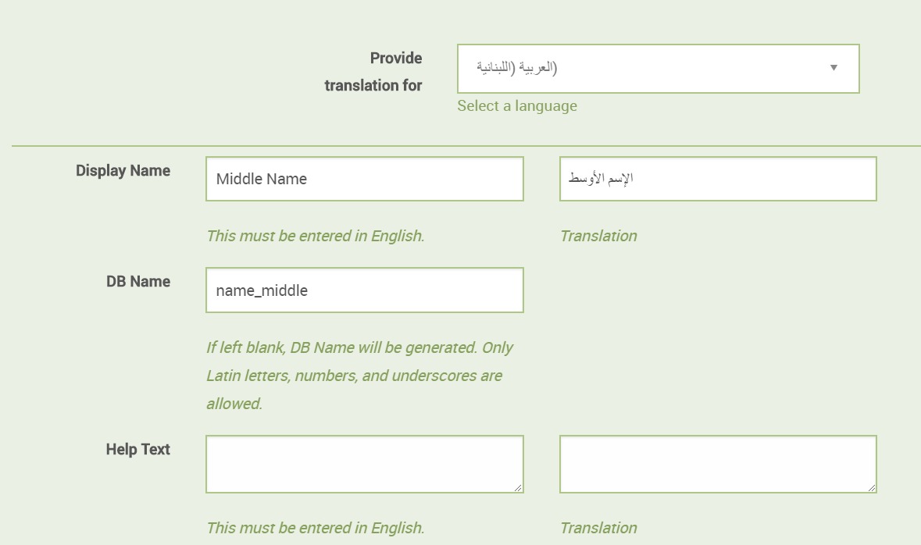
Editing a form field
Use the “Provide translation for” box to edit the translations for your field’s attributes.

Slide 27
Editing a form field
You must save a field in English before attempting to provide translations.

Slide 28
Editing a form field
You can change translations in a similar manner for lookups, forms, etc.

Slide 29
Practice

Slide 30
Lookups

Slide 31
Lookups
If you click on “Lookups” from the Forms page, you will go to the Lookups page

Slide 32
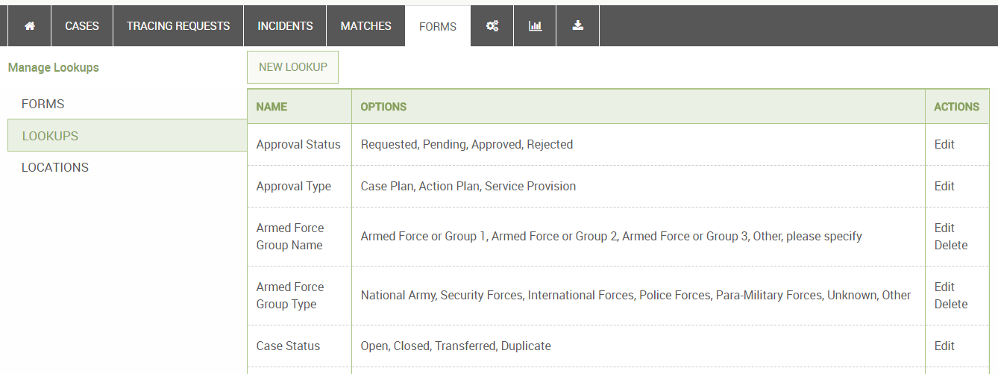
Lookups
Click the “Edit” button next to one of them.
Click the “New Lookup” button to add a new one.

Slide 33
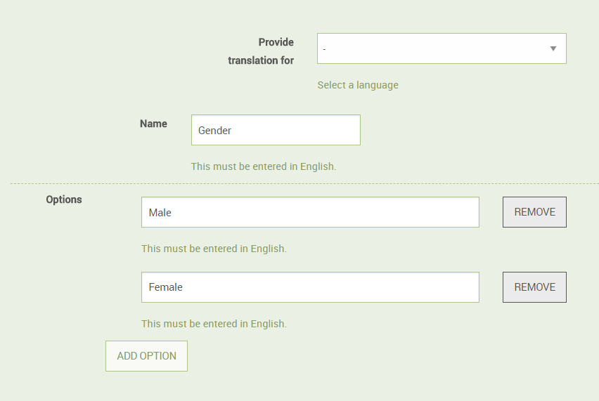
Lookups
Here, you can add or remove options or change the name of the lookup

Slide 34
Practice

Slide 35
Users

Slide 36
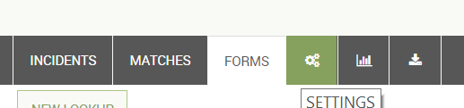
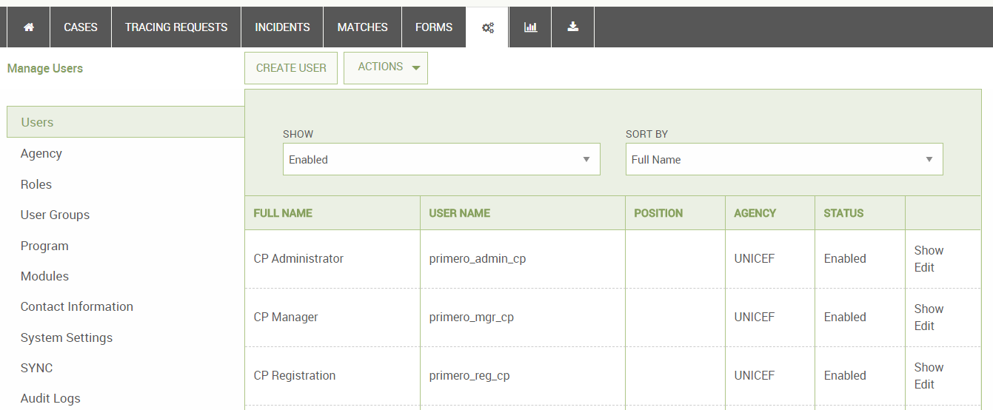
Users
If you click on the settings button, you will arrive at the users page

Slide 37
Users
Click “Create User” for a new user, and “Edit” next to any user to edit that user’s details.

Slide 38
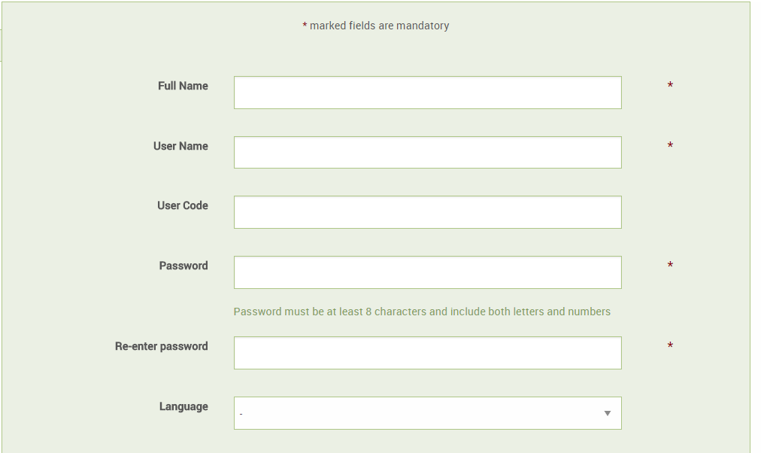
Creating a user
Fill out information on user, including
User Name
Password
Default Language
Email Address
Location
Agency

Slide 39
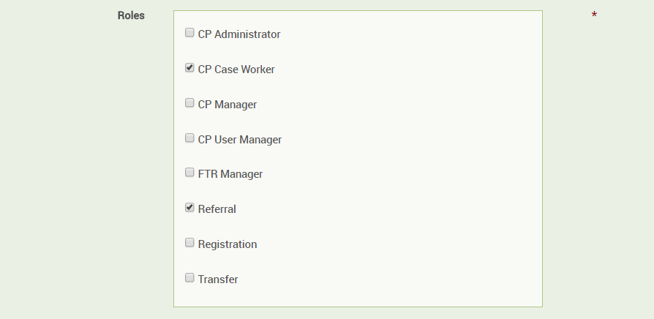
Selecting user roles
Roles
Control the actions a user is allowed to perform
A user can have multiple roles, though this is not recommended.

Slide 40
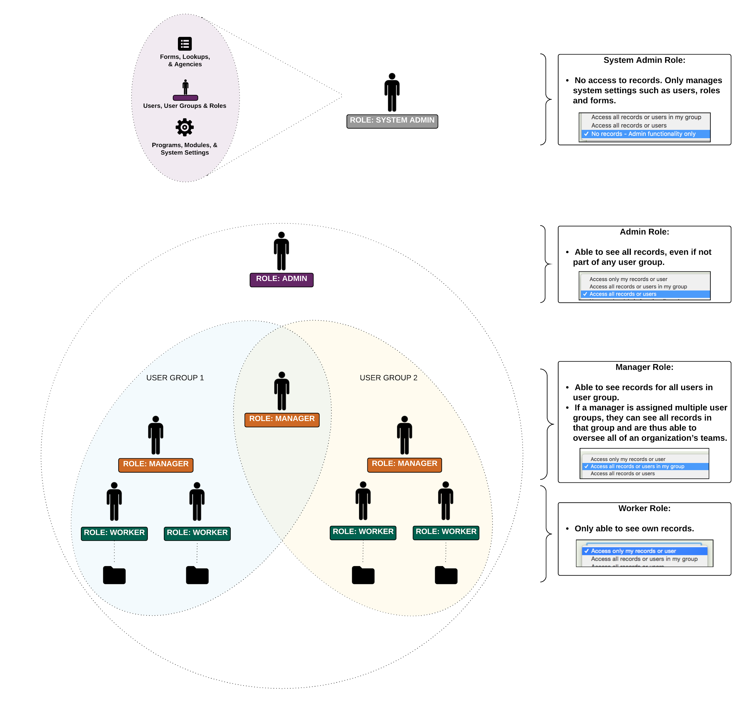
Some users - depending on which roles they have - can see all the cases of the users in their user groups.

Slide 41
A manager in one user group will see the cases of all the users in his or her user group . . .

Slide 42
. . . while a manager in two user groups can see the cases of the users in all these user groups.

Slide 43
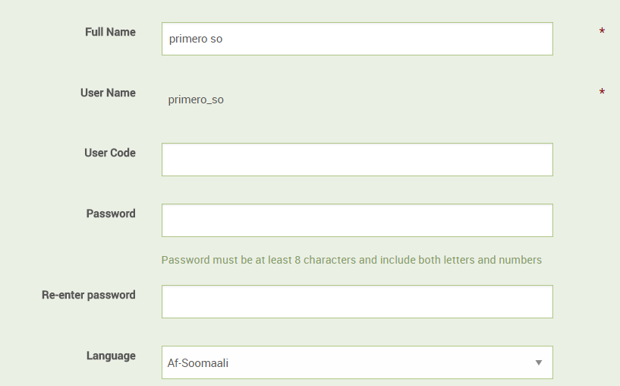
Editing a user
Similar to creating a user, except that you cannot change the User Name

Slide 44
Editing a user
You can use this form to reset a user’s password if they lose it

Slide 45
User groups let managers keep track of the case workers in their team

Slide 46
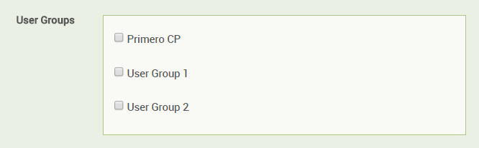
Selecting user groups
Select one or more user groups for your user

Slide 47
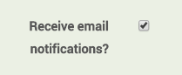
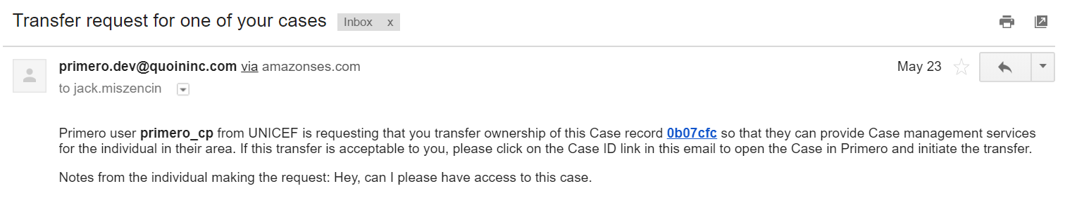
Email notifications
This setting controls whether user receives email notifications for things like
Sign up notification
Case plan approvals
Transfer requests
Case plan and closure approvals and approval requests

Slide 48
Practice

Slide 49
User Groups

Slide 50
User groups
From the Users page, you can click on “User Groups” to go to the User Groups page

Slide 51
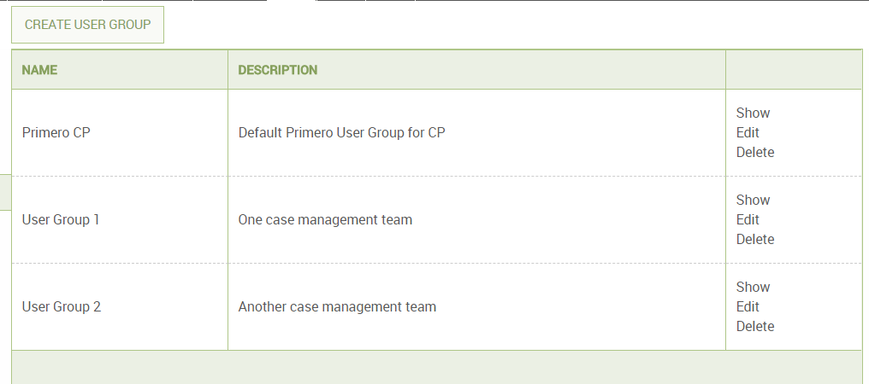
User groups
Here you can create a new user group or edit an existing one

Slide 52
Practice

Slide 53
Roles

Slide 54
Roles
From the Users page, you can click on “Roles” to go to the Roles page

Slide 55
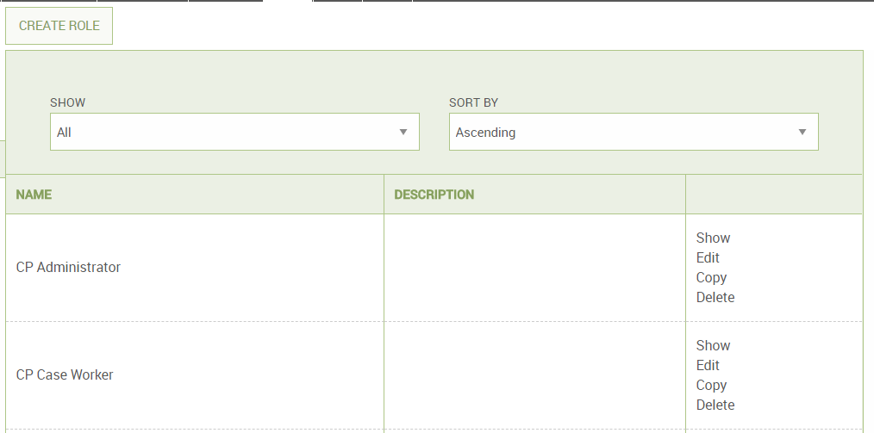
Roles
Here you can create a new role or edit an existing one

Slide 56
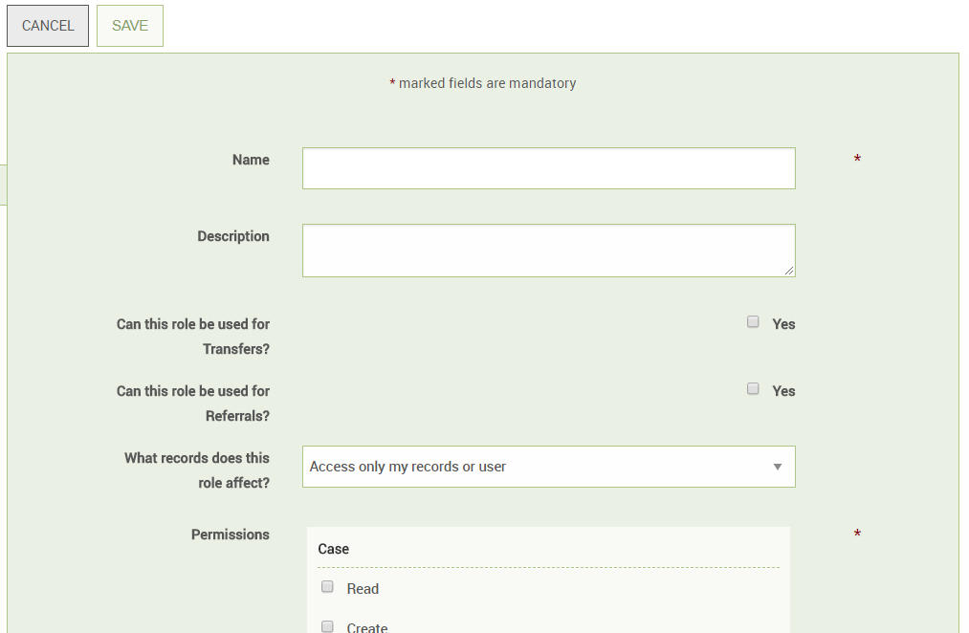
Creating a new role
Provide information on role attributes
Ability to transfer or refer cases
Which forms role can see
Which actions role can perform on which records
Group access
Admin access: users, roles, forms, etc.

Slide 57
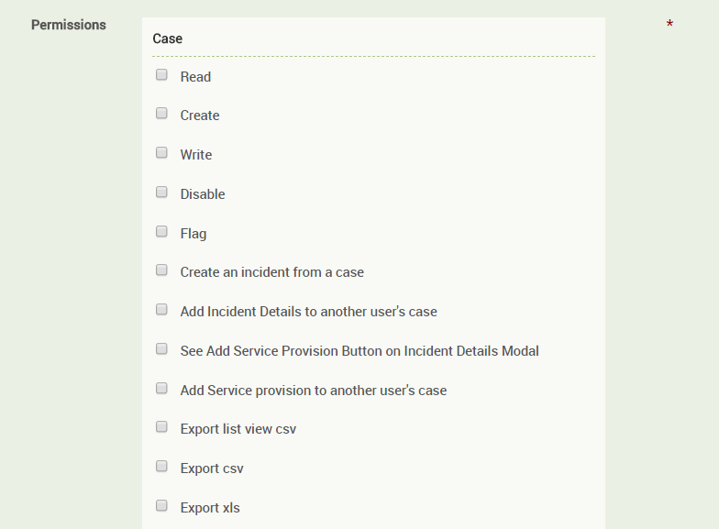
Creating a new role
Specify which actions the role can perform on which records (cases, tracing requests, and incidents)

Slide 58
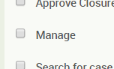
Creating a new role
The “Manage” permission gives the role access to all other permissions in the list

Slide 59
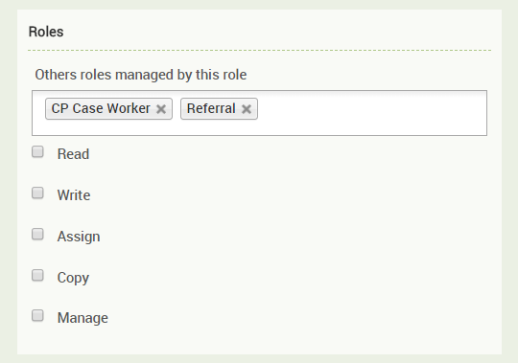
Creating a new role
You can specify which roles your role has access to
This allows you to create hierarchies of administrators in your organization

Slide 60
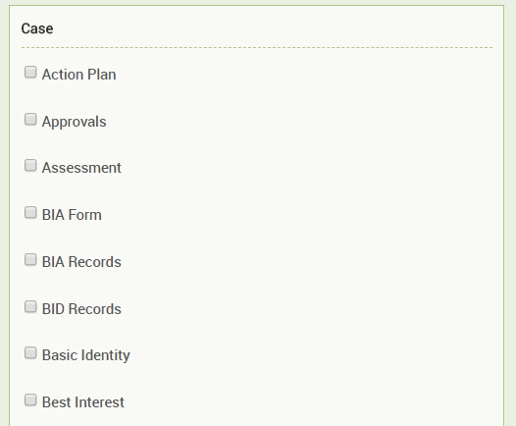
Creating a new role
In the forms section, you can specify which forms this role can see
If you check no forms, the role has access to all forms for that record
This is useful for controlling what information a user can see about a child

Slide 61
Roles have one of four types of “group access”:
Access only administrative features
Access all records in the system
Access all records in their user group
Access only their own records

Slide 62
Roles have one of four types of “group access”:
Access only administrative features
Access all records in the system
Access all records in their user group
Access only their own records

Slide 63
Roles have one of four types of “group access”:
Access only administrative features
Access all records in the system
Access all records in their user group
Access only their own records

Slide 64
Roles have one of four types of “group access”:
Access only administrative features
Access all records in the system
Access all records in their user group
Access only their own records

Slide 65
Roles have one of four types of “group access”:
Access only administrative features
Access all records in the system
Access all records in their user group
Access only their own records

Slide 66
Practice

Slide 67
Matching

Slide 68
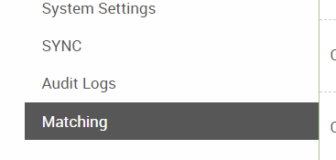
Matching Configuration
From the Users page, you can click on “Matching” to go to the Matching page

Slide 69
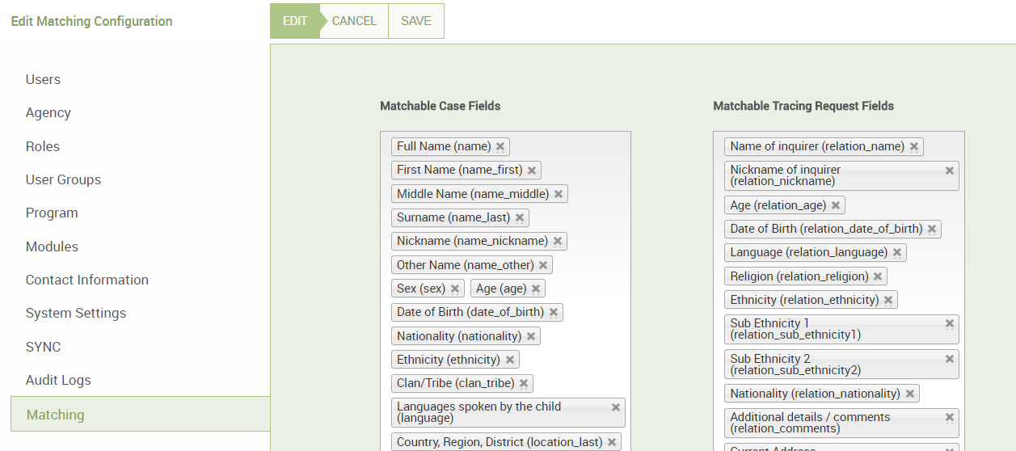
Matching Configuration
Here, you can control which fields are used to match cases with tracing requests

Slide 70
Reports

Slide 71
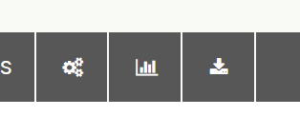
Reports
In the navigation bar, you can select the Reports icon to go to the Reports page.

Slide 72
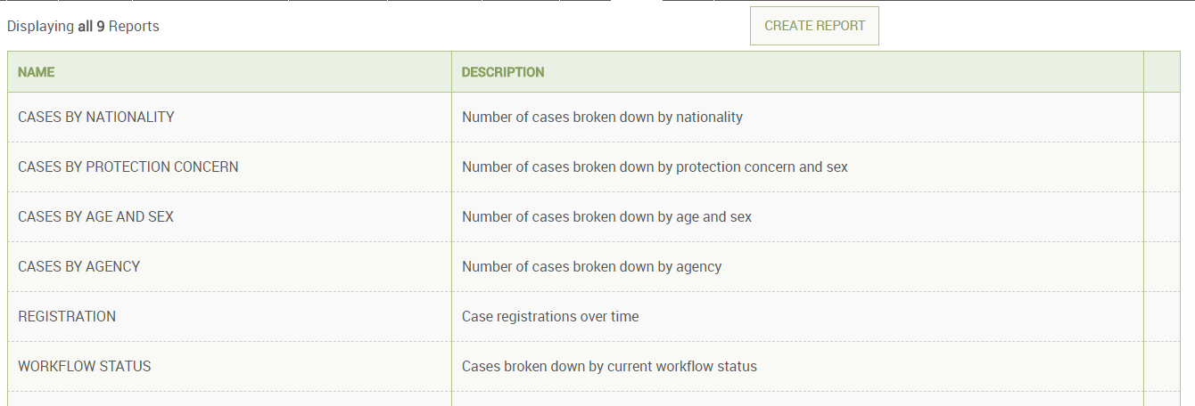
Reports
On the Reports page, you will see a list of pre-created reports. You can click on the name of any these.

Slide 73
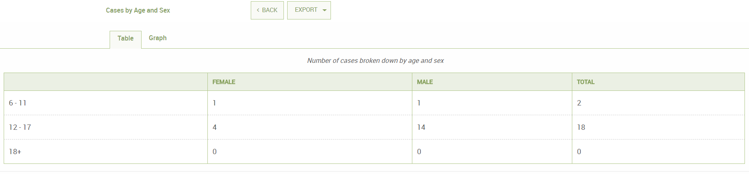
Reports
You will see a table outlining information in the report
Click on “Graph” to see a graph of the report

Slide 74
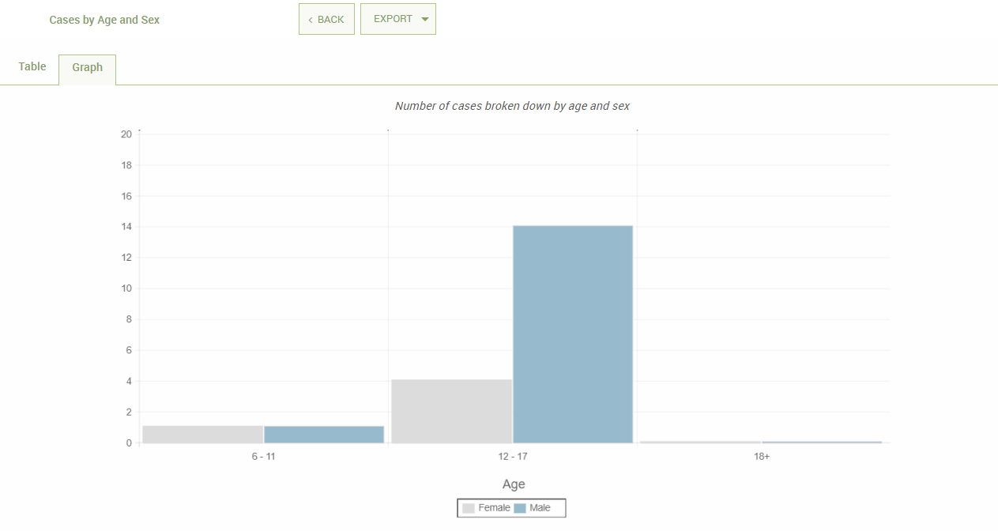
Reports
After clicking on “Graph,” you will see a graph of the report data.

Slide 75
Creating a Report
On the Reports page, click “Create Report.”

Slide 76
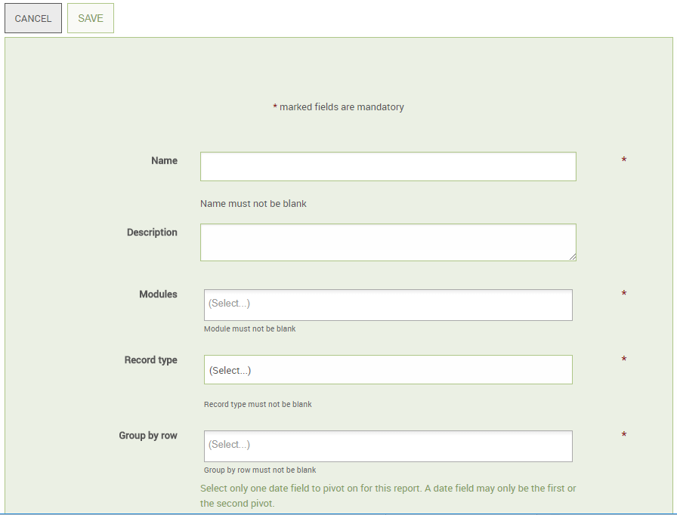
Creating a Report
Here, you fill out basic information about the report.

Slide 77
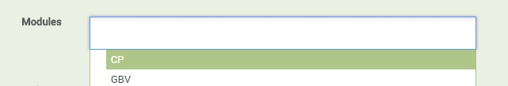
Creating a Report
Reports should always use the “CP” or “Child Protection” module.

Slide 78
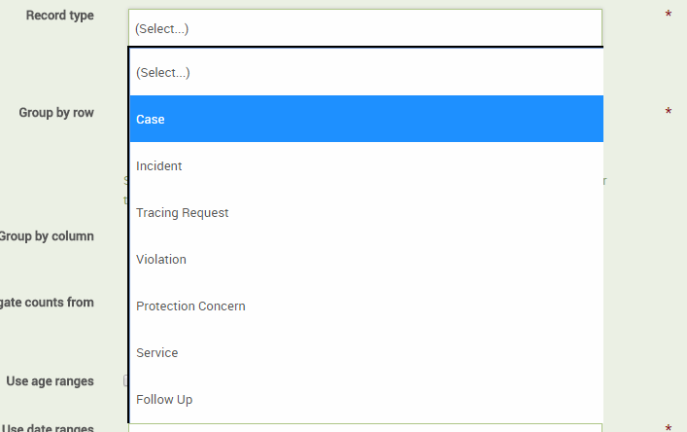
Creating a Report
To get information on cases, use “Case” as your record.
You can also report on all the services or all the follow ups which have been added to the cases in the system.

Slide 79
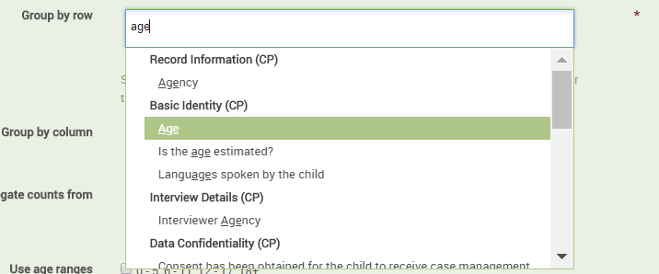
Creating a Report
Your reports will have attributes displayed in table rows and in table columns.
To select an attribute, type in the name of the attribute, then select one from the matching results.

Slide 80
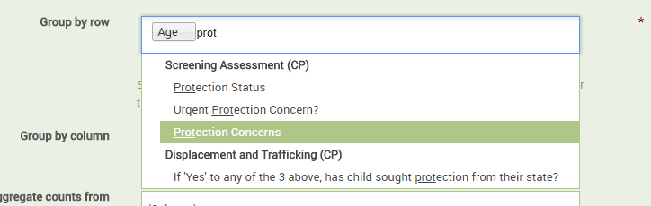
Creating a Report
You can select more than one attribute to display

Slide 81
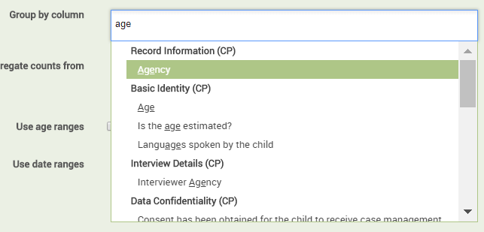
Creating a Report
You can select attributes to display on the table columns, too

Slide 82
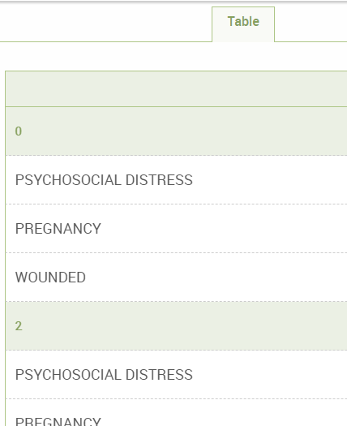
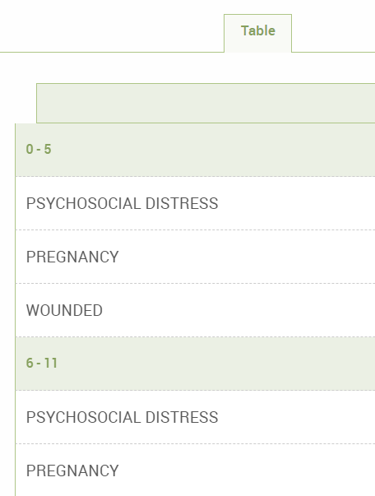
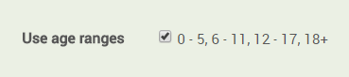
Creating a Report
If you use “Age” as an attribute, you can use age ranges to organize your report

Slide 83

Creating a Report
You can always go back and edit a report you’ve created by clicking the “Edit” button on the Report page

Slide 84
Practice

Slide 85
Configuration and User Bundles

Slide 86
Both users and the system and configuration can be managed through exported files.

Slide 87
Why would I ever want to export or import a configuration bundle?

Slide 88
All configuration changes should be tested on a VM before releasing to users.

Slide 89
Configuration bundles help you move your changes from one environment to another.

Slide 90


Configuration Bundles
Go to the Settings page

Slide 91

Configuration Bundles
To import a configuration bundle, click, Actions, then Import, then Configuration Bundle

Slide 92

Configuration Bundles
Choose a configuration file from your computer, then click “Import.”

Slide 93

Configuration Bundles
To export your current configuration to a file, click Actions, then Configuration Bundle, then Export

Slide 94

Configuration Bundles
Enter a password, a name for your exported file, and then click “OK” to download the config file

Slide 95

Configuration Bundles
You will need the password you entered to open the file later

Slide 96
Configuration Bundles
Go to the Settings page

Slide 97

User Bundles
Click on Actions, then Import, then Users

Slide 98

User Bundles
Choose a user bundle file from your computer
Enter a password if the file is encrypted
Click Import

Slide 99

User Bundles
Click on Actions, then Export, then Users

Slide 100

User Bundles
Enter a password for your file
Pick a name for the user file
Click OK to download the file

Slide 101

User Bundles
You will need the password you entered to open the file later

Slide 102
Final Practice
Notes:
Use the case study

